Slide 1


Slide 2
Agenda
¿Que es el CNCF?
CNCF Radar
Continuous Delivery
Observability
Database storage
Secret management
VASS Radar
VASS Radar // Governance
TMS K8S Architecture v0.2.0
Referencias

Slide 3
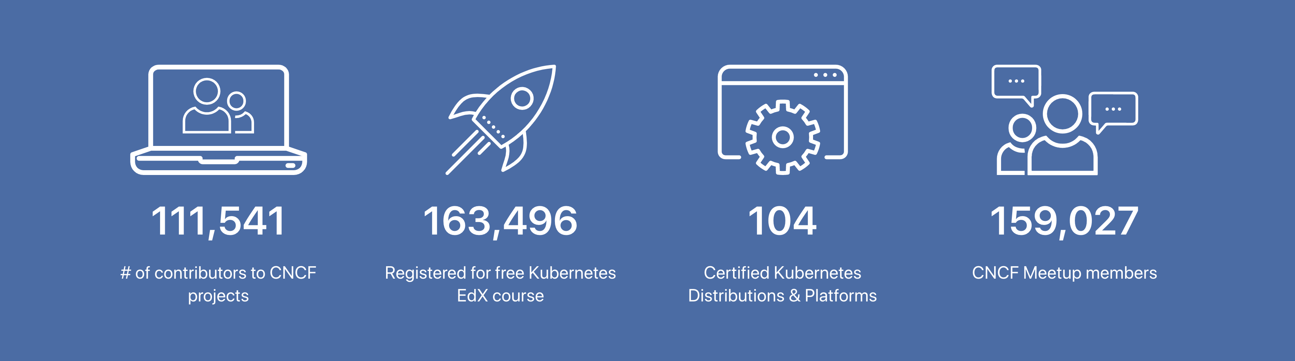
¿Que es el CNCF?
The Cloud Native Computing Foundation (CNCF) hosts critical components of the global technology infrastructure.
CNCF is part of the nonprofit Linux Foundation.
CNCF serves as the vendor-neutral home for many of the fastest-growing open source projects, including Kubernetes, Prometheus, and Envoy.

Slide 4
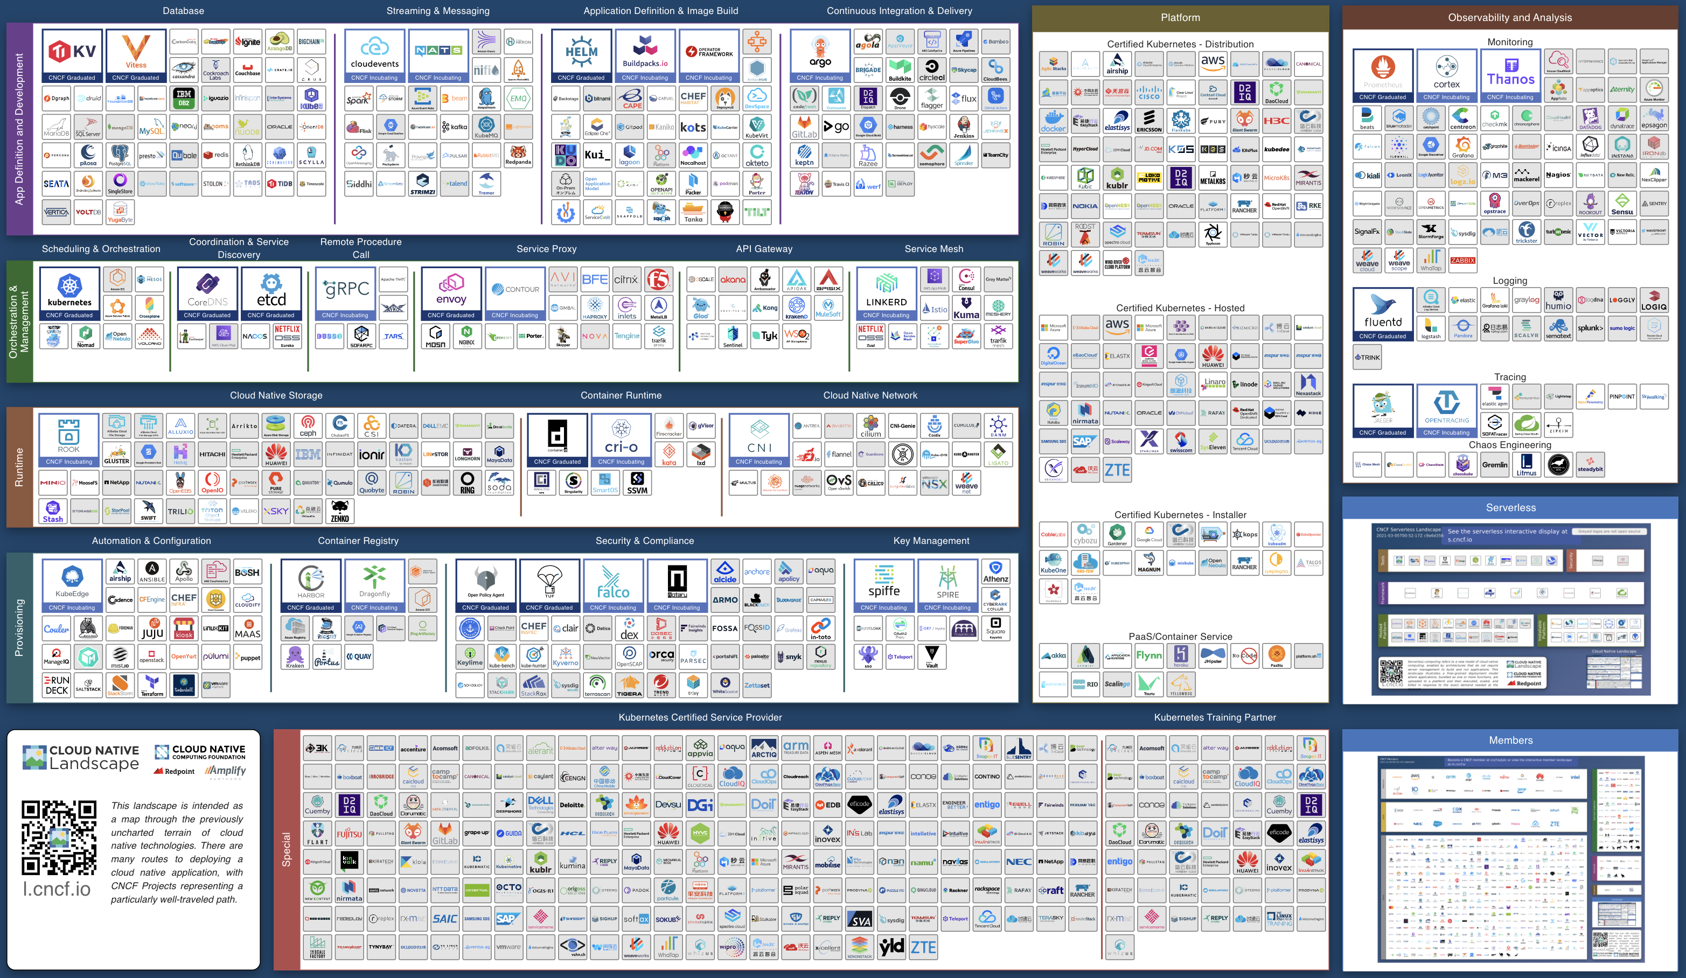

Slide 6
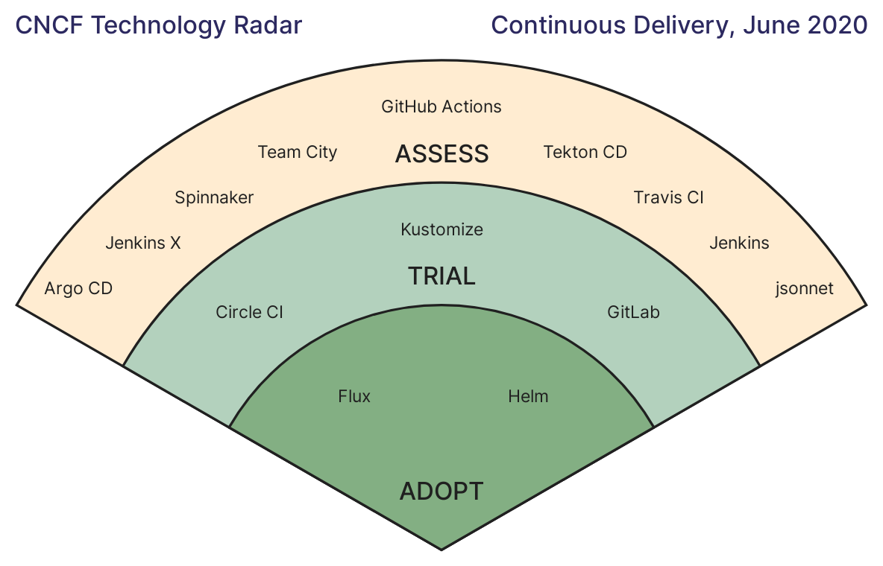
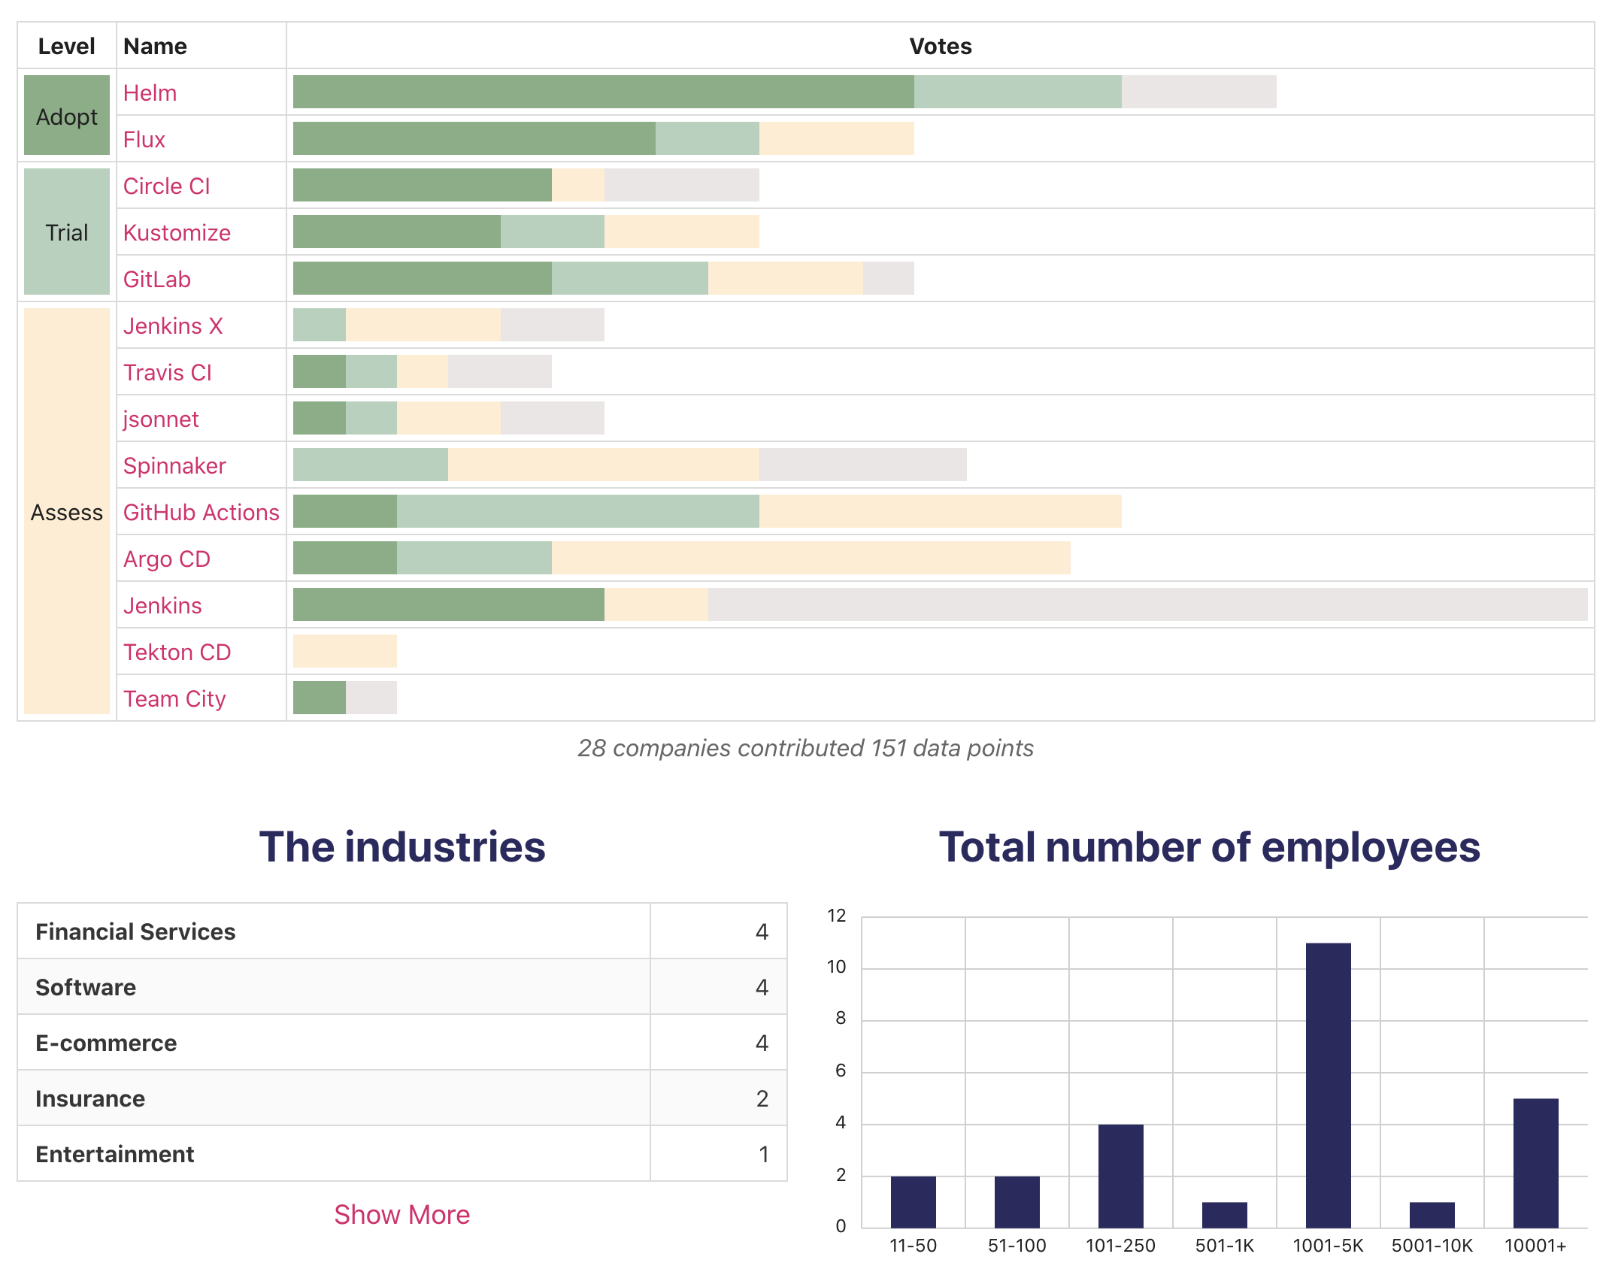
CNCF Radar
Continuous Delivery

Slide 7
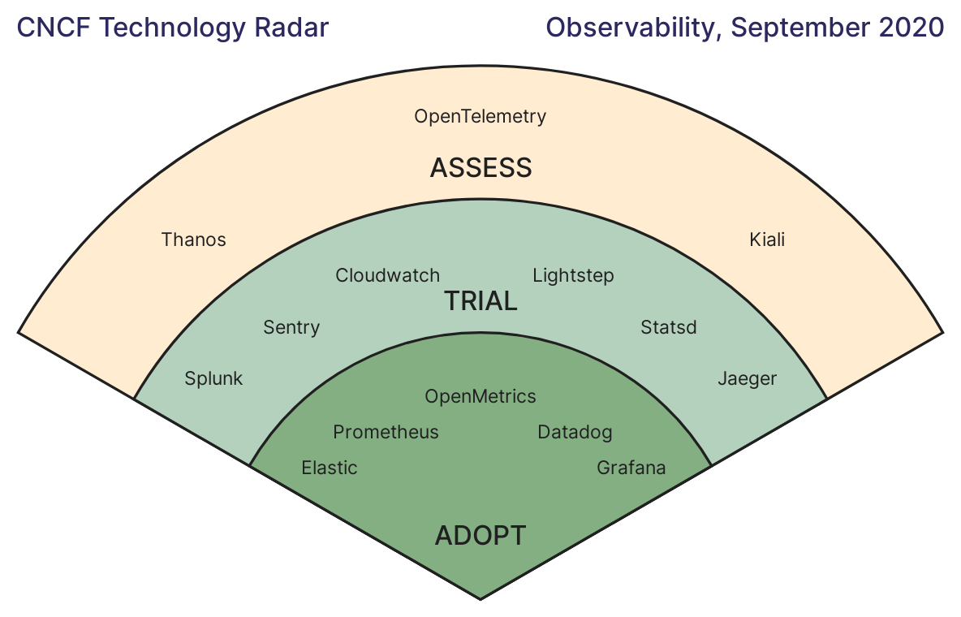
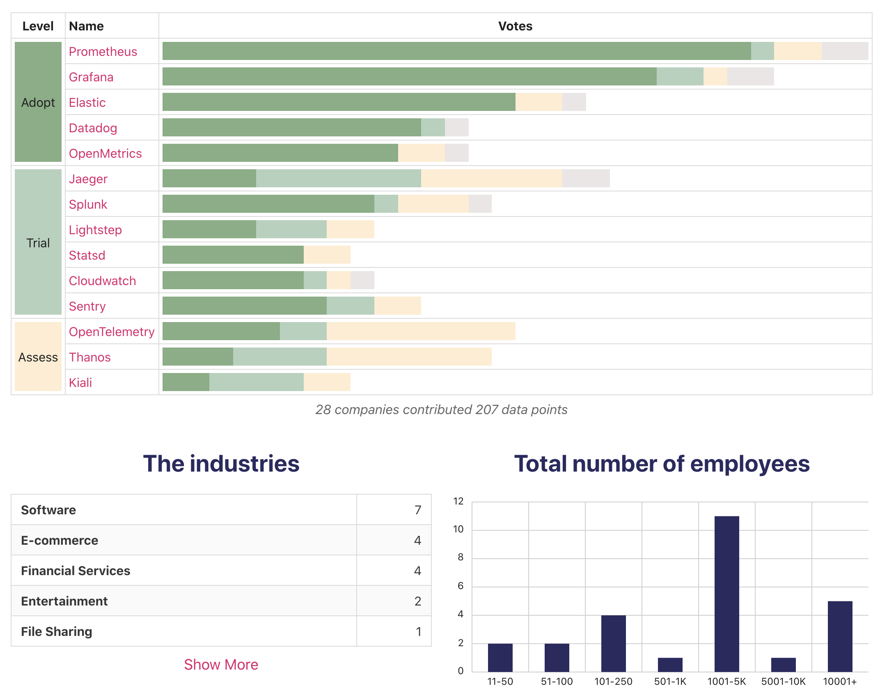
CNCF Radar
Observability

Slide 8
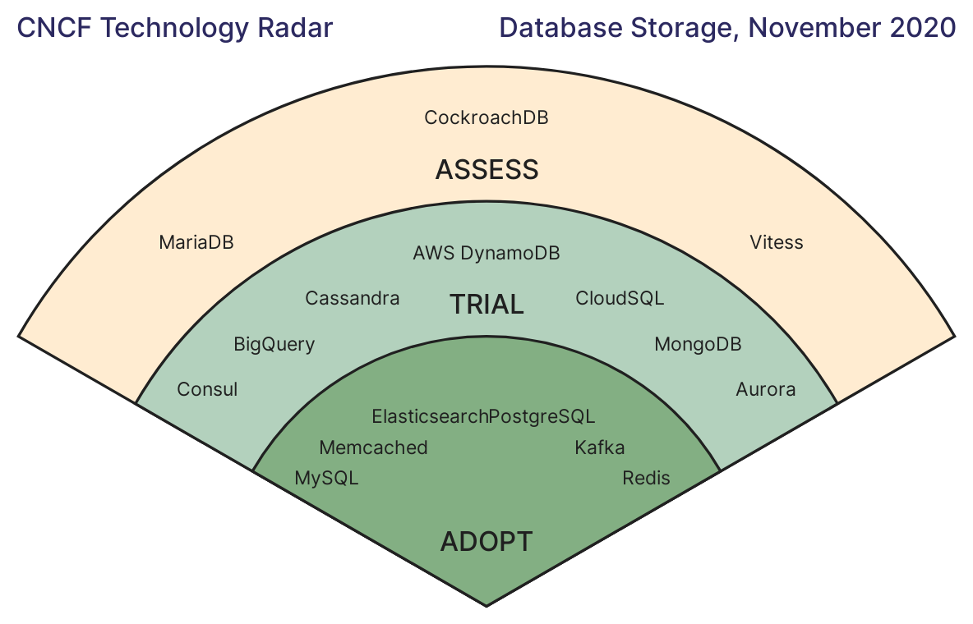
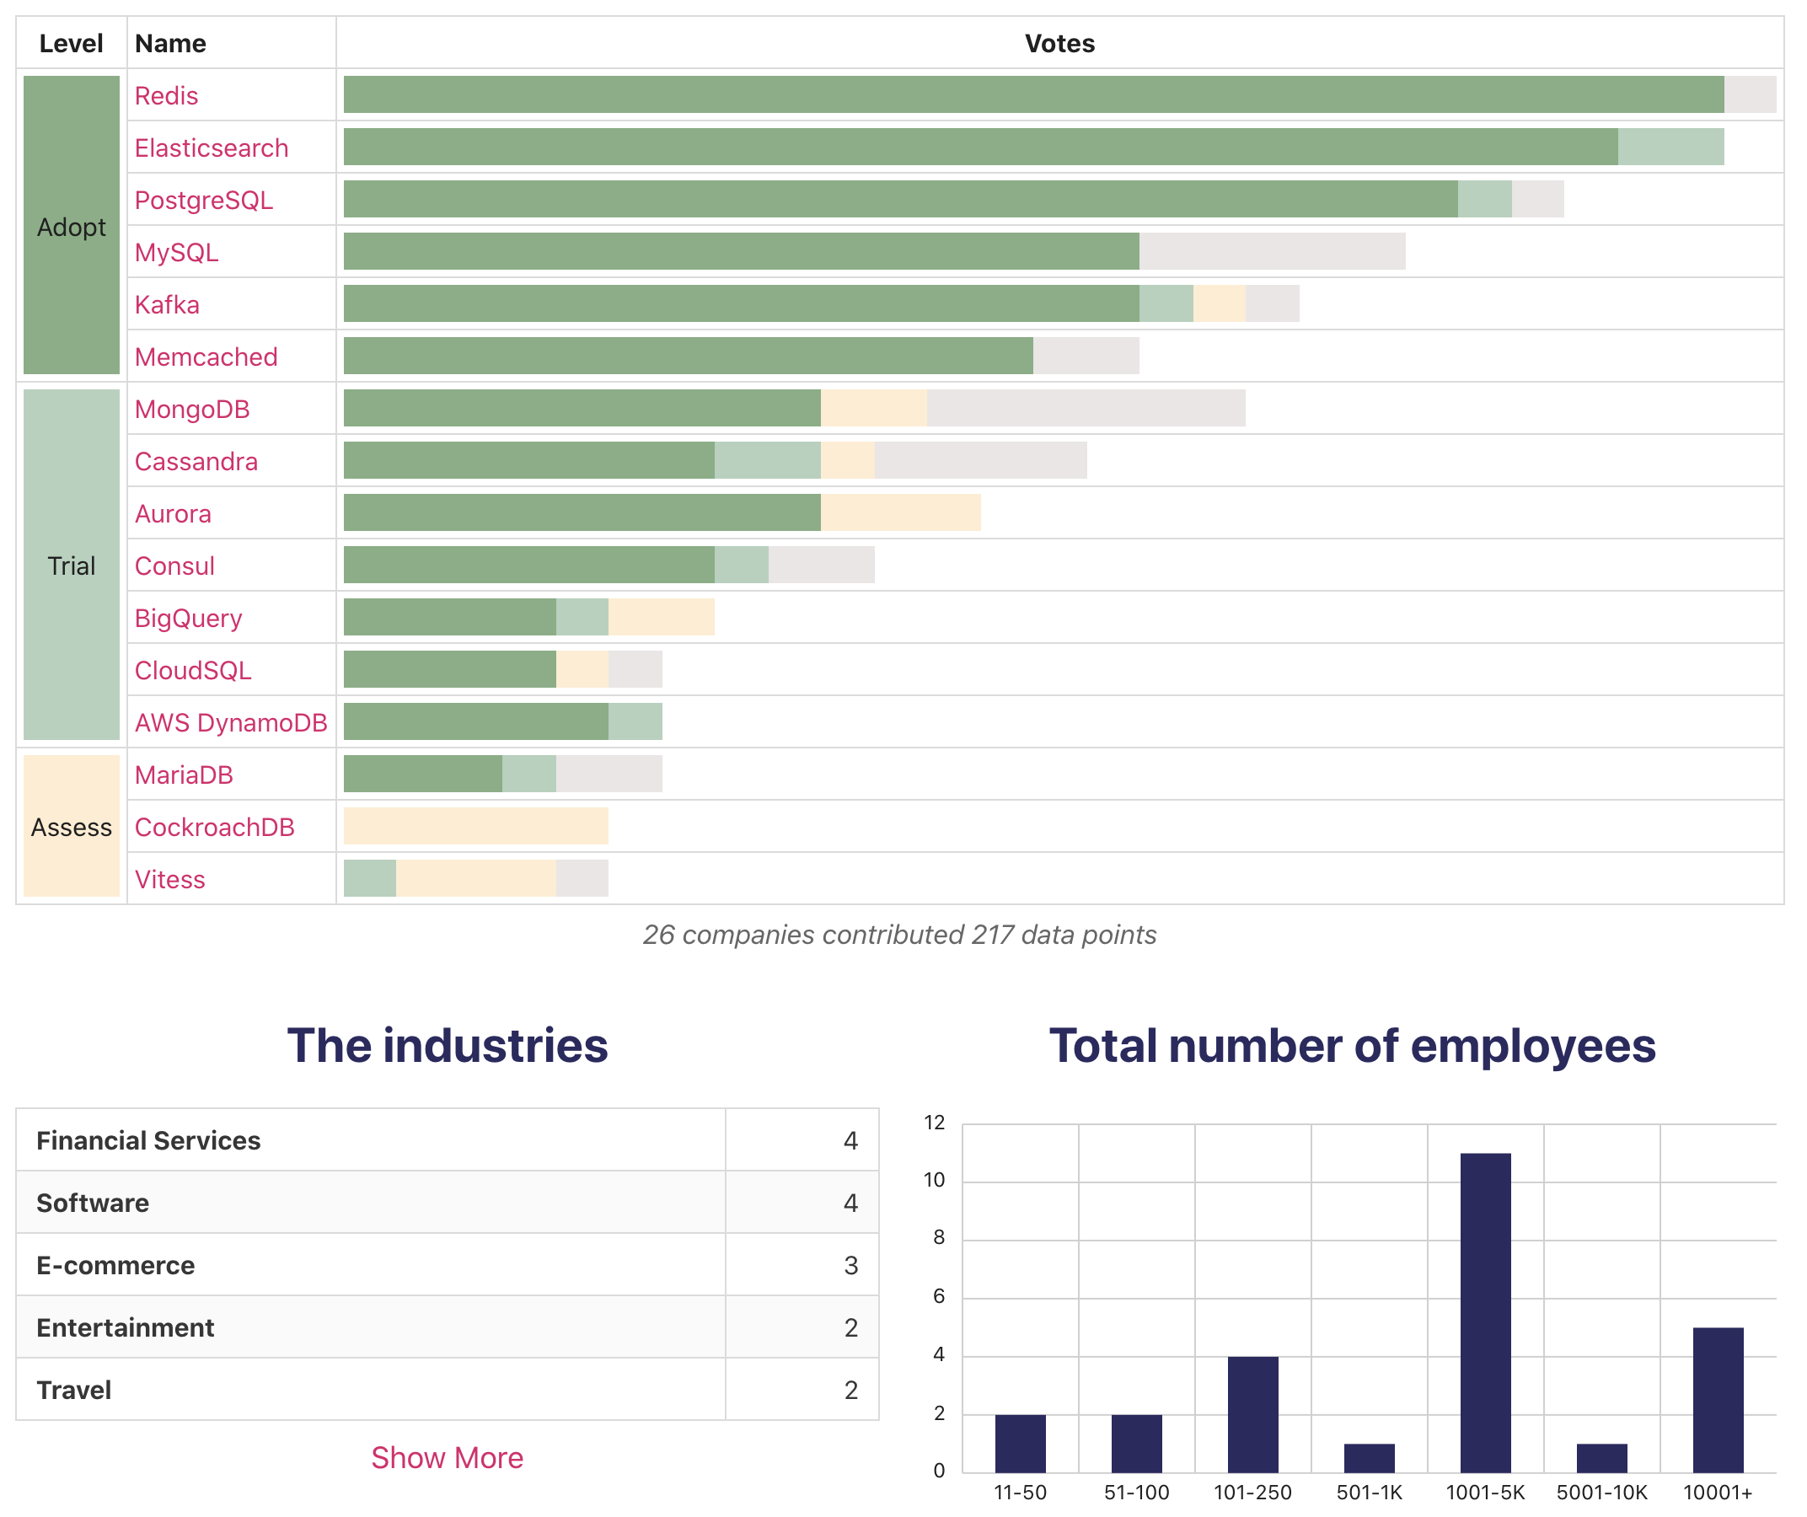
CNCF Radar
Database Storage

Slide 9
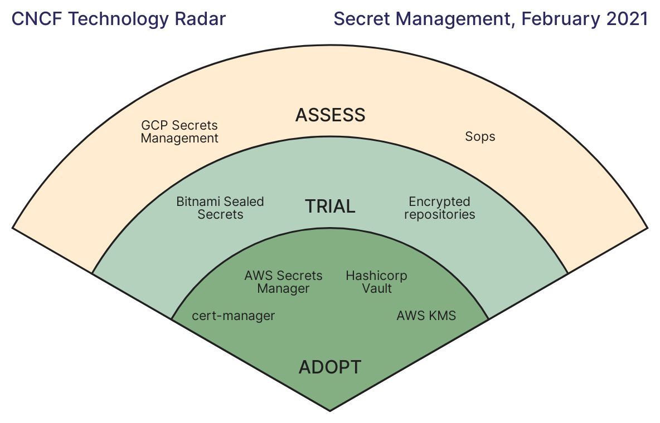
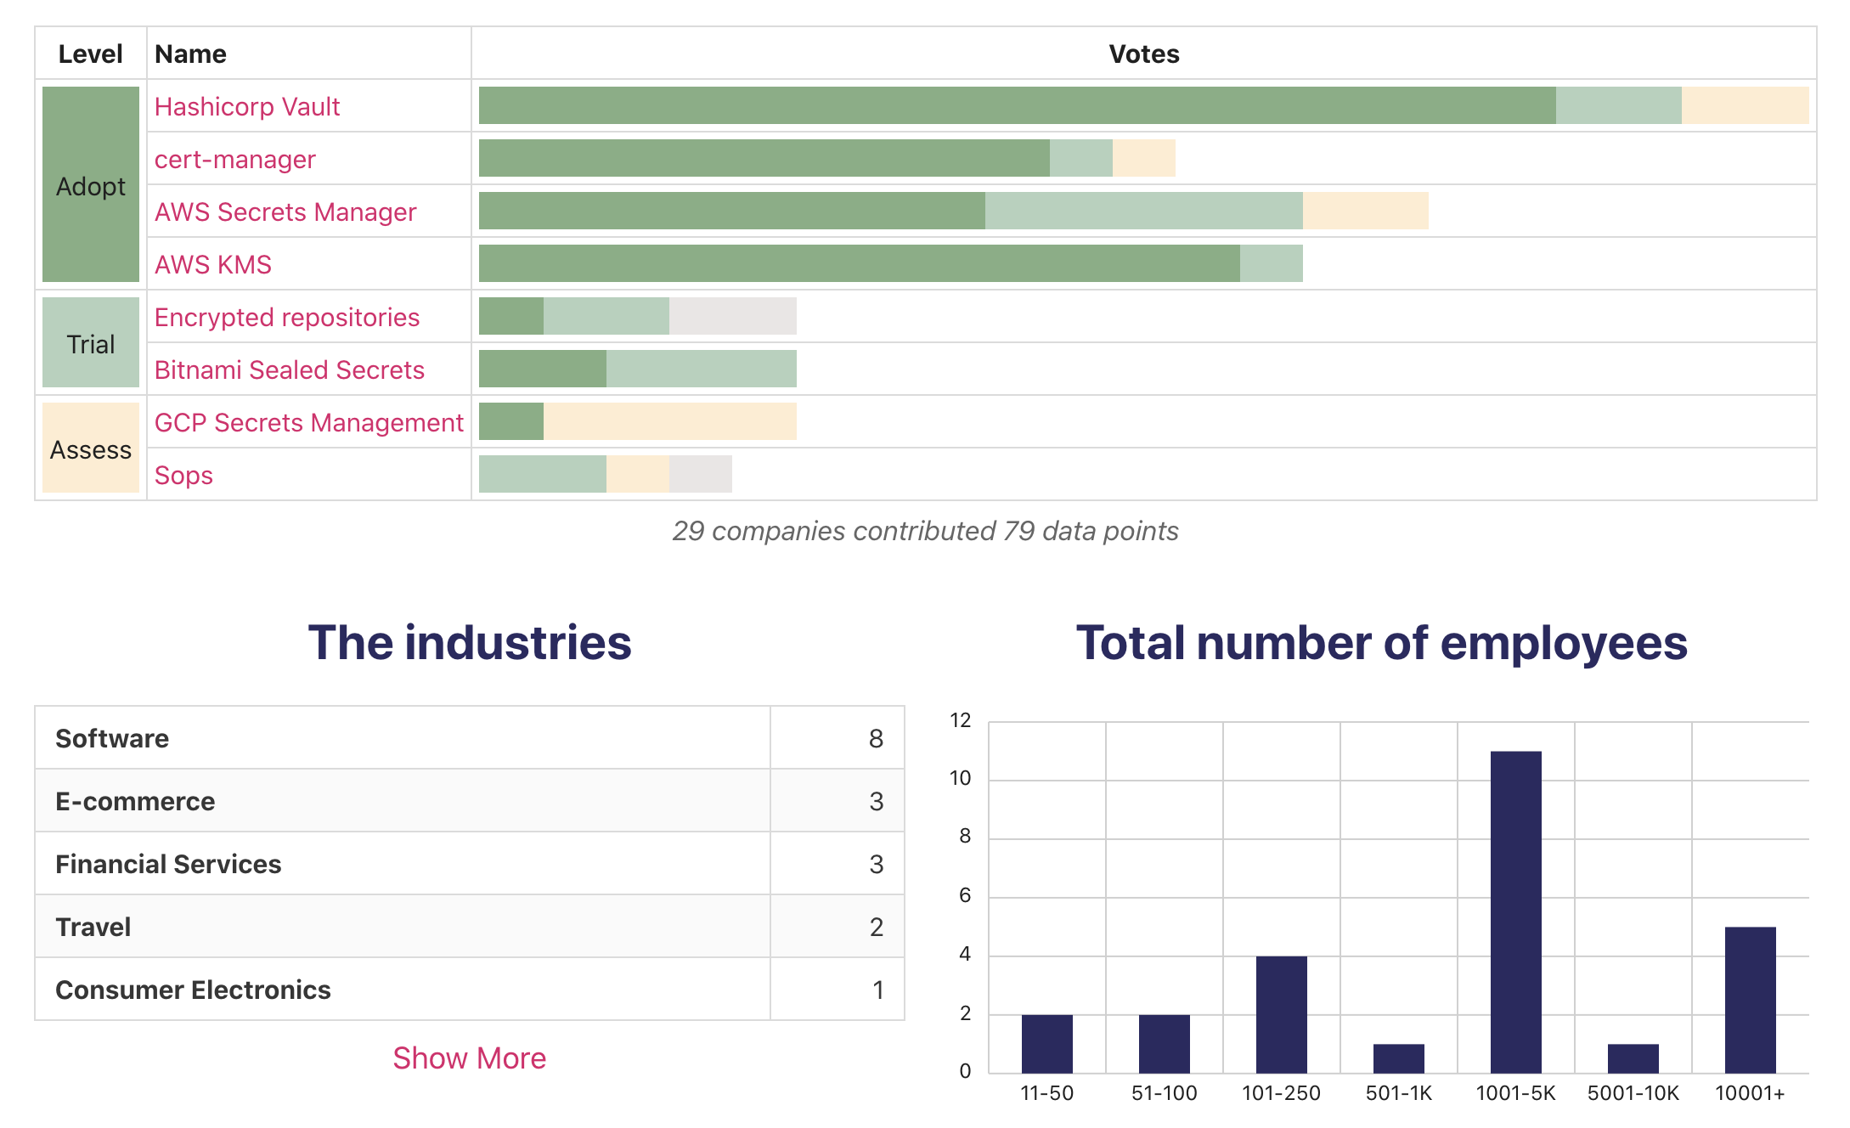
CNCF Radar
Secret Management

Slide 10
VASS Radar

Slide 11
VASS Radar
“El radar tecnológico facilita la vigilancia del mercado y de la tecnología, que debería ser parte cotidiana en un entorno cambiante.”

Slide 12
VASS Radar governance
Governance & Infrastructure | Tech & Cloud | Infrastructure as Code | 1 Adoptar
Governance & Infrastructure | Tech & Cloud | GitOps | 2 Probar
Governance & Infrastructure | Tech & Cloud | Cloud Workloads Protection Platform (CWPP) | 2 Probar
Governance & Infrastructure | Tech & Cloud | Multicloud Management | 2 Probar
Governance & Infrastructure | Tech & Cloud | Kubernetes | 1 Adoptar
Governance & Infrastructure | Tech & Cloud | Red Hat Openshift | 1 Adoptar
Governance & Infrastructure | Tech & Cloud | Azure Kubernetes Service (AKS) | 1 Adoptar
Governance & Infrastructure | Tech & Cloud | Amazon Enterprise Kubernetes Services (EKS) | 1 Adoptar
Governance & Infrastructure | Tech & Cloud | Google Kubernets Engine (GKE) | 2 Probar
Governance & Infrastructure | Tech & Cloud | Tanzu | 3 Evaluar
Governance & Infrastructure | Tech & Cloud | Google Cloud Platform | 2 Probar
Governance & Infrastructure | Tech & Cloud | Google Anthos | 3 Evaluar
Governance & Infrastructure | Tech & Cloud | Terraform | 1 Adoptar
Governance & Infrastructure | Tech & Cloud | Ansible Tower | 1 Adoptar
Governance & Infrastructure | Tech & Cloud | ArgoCD | 2 Probar
Governance & Infrastructure | Tech & Cloud | AWS CloudFormation | 1 Adoptar
Governance & Infrastructure | Tech & Cloud | Istio/Linkerd/Envoy | 2 Probar
Governance & Infrastructure | Tech & Cloud | Velero | 2 Probar
Governance & Infrastructure | Tech & Cloud | Kubernetes Operators | 2 Probar
Governance & Infrastructure | Tech & Cloud | Okteto | 1 Adoptar
Governance & Infrastructure | Tech & Cloud | Prisma Cloud (Palo Alto) | 1 Adoptar
Governance & Infrastructure | Tech & Cloud | Cloud Health | 2 Probar
Governance & Infrastructure | Tech & Cloud | Vitess | 2 Probar

Slide 13
VASS Radar governance
Clan | Consejo | Nombre | Anillo
Governance & Infrastructure | DevOps | Ansible | 1 Adoptar
Governance & Infrastructure | DevOps | Pipelines as Code | 1 Adoptar
Governance & Infrastructure | DevOps | Pipeline Jenkins | 3 Evaluar
Governance & Infrastructure | Security | API Security / OAuth2 / OpenID Connect | 1 Adoptar
Governance & Infrastructure | Security | Priviledge Access Management (PAM) | 1 Adoptar
Governance & Infrastructure | Security | Soluciones de doble factor y Risk management | 3 Evaluar
Governance & Infrastructure | Security | SIEM (Security Information and Event Manager | 3 Evaluar
Governance & Infrastructure | Security | Azure AD | 2 Probar
Governance & Infrastructure | Security | Okta | 3 Evaluar
Governance & Infrastructure | Security | Google Identity | 3 Evaluar
Governance & Infrastructure | Security | Cyberark | 1 Adoptar
Governance & Infrastructure | Security | One Identity | 3 Evaluar
Governance & Infrastructure | Security | Beyond Trust | 3 Evaluar
Governance & Infrastructure | Security | Azure Security Center | 3 Evaluar

Slide 14











REST Landscape
Servicios
Aplicación
Infrastructure
Dev Ops

Slide 15


Event-Driven Landscape
Servicios
Aplicación
Broker
Infrastructure
Dev Ops

Slide 16
Referencias
https://www.cncf.io/
https://radar.cncf.io/
https://github.com/cncf/trailmap
https://landscape.cncf.io/
https://www.cncf.io/reports/#project-journey-reports

Slide 17
Gracias
🙏 🙏 🙏

